Slide 1
Securing Data Hiding In Image Using Steganography
AICTE PROJECT
Presented By: Rafia Sunmbul
Student Name : Rafia Sunmbul
College Name & Department : Zakir Husain Dellhi College
Dep. : B.A (Hons.) Arabic

Slide 2
OUTLINE
Problem Statement
Technology used
Wow factor
End users
Result
Conclusion
Git-hub Link

Slide 3
Problem Statement
The Steganography Tool is designed to help users hide secret messages inside images in a simple and secure way.
Using a technique called Least Significant Bit (LSB) steganography, it allows users to embed hidden text within image files.
The tool features an easy-to-use interface built with Tkinter, where users can select images, type in their messages, and save the modified image.
For extra security, the tool includes a password feature to protect access to the hidden messages. It's perfect for anyone looking to keep their information private or learn about cryptography.

Slide 4
Technology used
Platform: PyCharm 2024.3.3.
Libraries Used:
os: For interacting with the operating system, handling file paths, and opening file dialogs.
tkinter: For building the graphical user interface (GUI) of the application.
Pillow (PIL): For image processing tasks such as opening, resizing, and displaying images.
Stegano: To encode and decode secret messages in images using Least Significant Bit (LSB) Steganography.
messagebox (from tkinter): For displaying pop-up message boxes with alerts, error messages.
The Key Functions Used :
Image selection and display using open_img().
Message hiding and saving using hide_and_save().
Message retrieval using show().
Resetting the app with reset().
Button hover effects for better interactivity with button_style() and reset_button_style().

Slide 5
Wow factors
The tool uses libraries like Tkinter, which is cross-platform, that allows it to run on Windows, macOS, and Linux without requiring any changes to the code.
Reset Functionality: The application includes a reset button that clears all inputs, resets the application state to start fresh with a clean slate.
Image Preview and Customization: The project allows users to select and view the image before performing any steganography operations to allow user working with the correct image.
Additionally, the image is displayed in a frame with customizable size (e.g., resizing to 300x220), allowing the user to view it clearly without distortion.
Graphical User Interface (GUI): Many steganography projects are command-line based, but this tool uses Tkinter, providing a user-friendly graphical interface. It allows users to easily interact with the tool without needing any technical knowledge or command-line commands.
Button hover effects for better interactivity with button_style() and reset_button_style().
This Steganography Tool stands out due to its combination of simple steganographic techniques with a modern, interactive GUI. The inclusion of features like password protection, resizable image preview, real-time feedback messages, and cross-platform compatibility makes it a unique and user-friendly solution for hiding and revealing secret messages in images. The focus on ease of use, security, and interactivity enhances the tool's value and makes it more approachable for a wide audience.

Slide 6
End users
General Public (For Privacy and Security) : Individuals who are concerned about privacy and security may use the tool to hide sensitive information within images. This tool allows users to protect confidential messages from being easily detected by others.
Students and Educators (For Learning and Teaching) : Students and educators in the fields of computer science, information security, and cryptography may use this tool as part of their learning process.
Security Professionals (For Securing Data) : Professionals in the field of cybersecurity and data protection may use steganography tools for legitimate purposes, such as creating secure communication channels.
Cryptography Enthusiasts (For Hobbies and Experimentation) :Individuals who are interested in cryptography, encryption, and digital security might enjoy experimenting with steganography techniques as a hobby.
This Steganography Tool serves a wide range of end users, including the general public for personal privacy, students and educators for educational purposes, cybersecurity professionals, cryptography enthusiasts, journalists and activists for secure communication, businesses for confidential messaging, and researchers working on steganography or encryption. The tool's flexibility, ease of use, and security features make it suitable for both novices and experts in the field of digital security and data privacy.

Slide 7
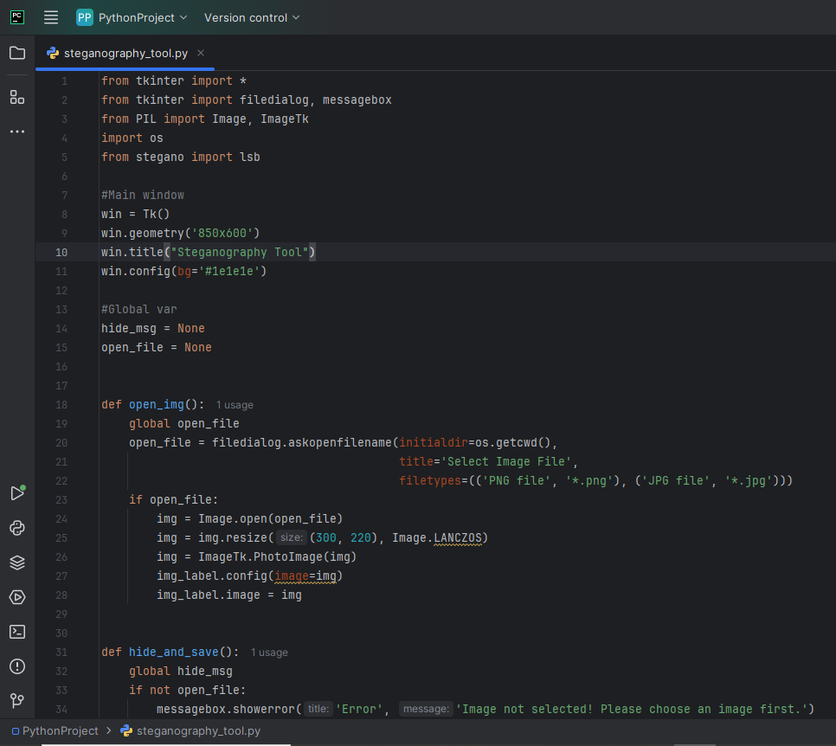
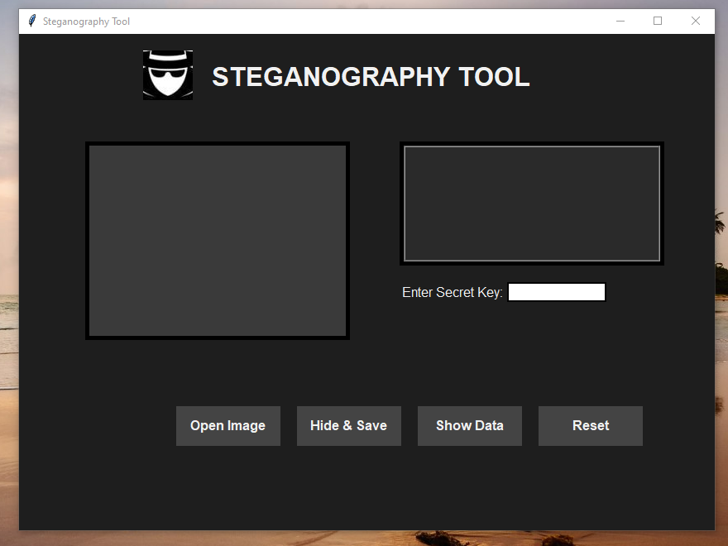
Results
OUTPUT
MAIN SCREEN
CODE

Slide 8
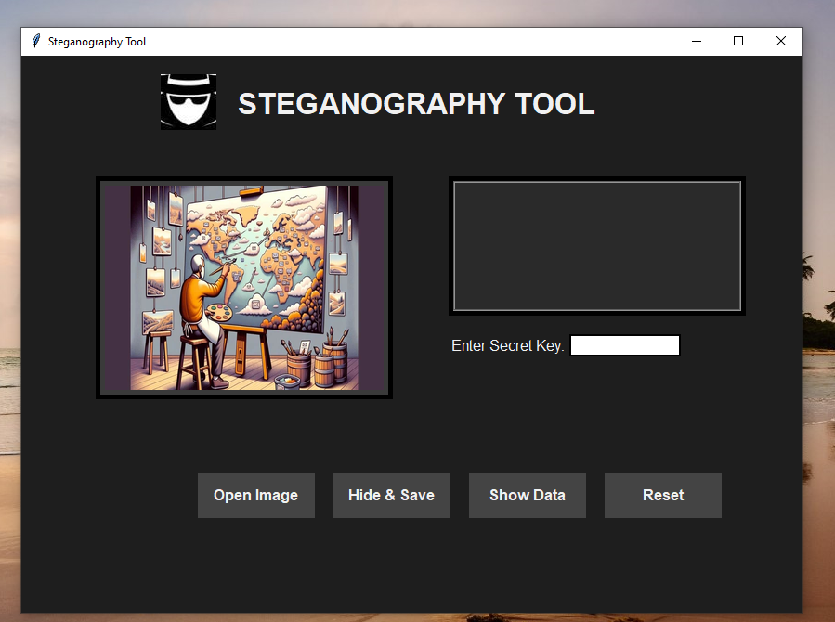

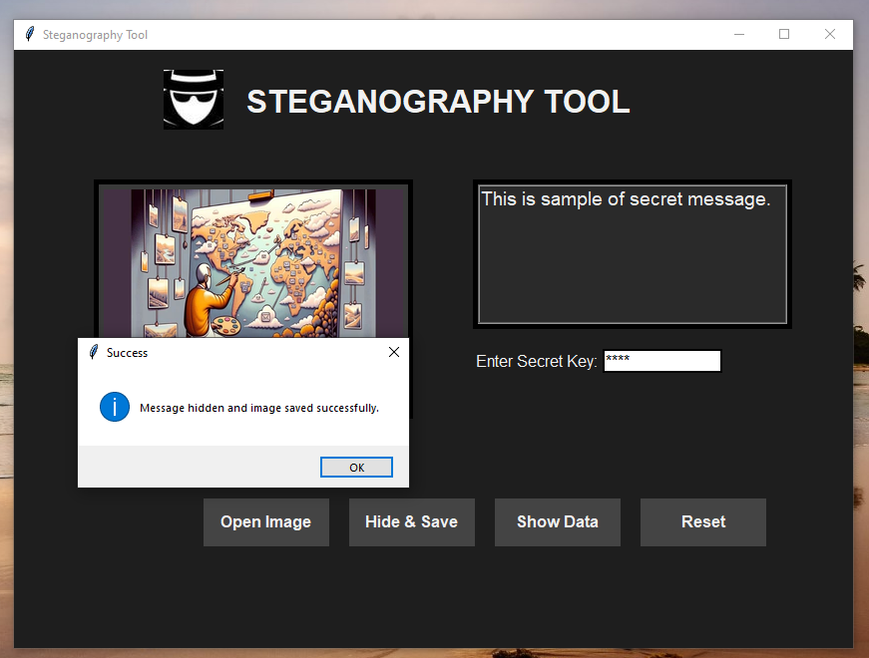
OUTPUT
INPUT
SAVED

Slide 9
Conclusion
In conclusion, the Steganography Tool successfully addresses the need for a simple yet effective way to hide and retrieve secret messages within images, ensuring secure communication and privacy.
By utilizing LSB steganography and providing an intuitive Tkinter GUI, the tool is accessible to both technical and non-technical users.
The integration of password protection further enhances the security of hidden data.
This project not only serves as a practical solution for individuals and professionals seeking privacy but also offers an educational platform for learning about data security and cryptography.

Slide 10
GitHub Link
https://github.com/Rafiasumbul/AICTE--project.git

Slide 11
THANK YOU

